Slide 1
Big Data Analytics: Santander Product Recommendation
Albert Bastian (1303029)
Supervisor: Dr. Li Gang Min

Slide 2
Overview
Introduction (About the project & Data)
Project & Data Description
Goals/Objectives
Project Work Flow
Exploratory Data Analysis (EDA)
Feature Engineering (i.e. data training) and selection
Data Split (7 Lags: June 2015, December 2015, Jan 2016 - May 2016 & new customer)
Validation
Base Model
Xgboost model
Base Model Combination
Submission
Conclusion

Slide 3
Intro (About the project):
It is a part of data science competition (hosted by kaggle), where the goal is to predict which new banking products will most likely be purchased by the customer from their past purchase record and their personal data (e.g. age, occupation, etc.).

Slide 4
a. (Intro) About the Data
Training Data, contains a monthly record of nearly 1 million users/customers and their product ownerships from January 2015 to May 2016 (i.e. 16 Months).
Test Data, consist of exactly 929,615 users
The data consists of 24 predictors including the age and income of the users. Product data consists of boolean flags (1/0, i.e., true/false) for all 24 products and indicates whether the user owned the product in the respective months.

Slide 5
B. Main Objective/Goal
Make a prediction on which new product will likely to be used by the users (i.e. users in the “test data”) in the next month (June 2016) based on their past records or month lags (January 2015 to May 2016) on customer behaviour and their relation/correlation between different monthly records (or product lags).
I.e. predict future new products purchase (i.e. in June 2016) based on the past records (January 2015 - May 2016).

Slide 6
2. Work Flow Exploratory Analaysis (EDA)
Age Distribution (excluding 2 other top features: income and Customer Seniority)
Top/Major Products (From Jan 2015 to May 2016)
Main Insights (Product Analysis on June 2015)
Product-to-Product Correlation

Slide 7
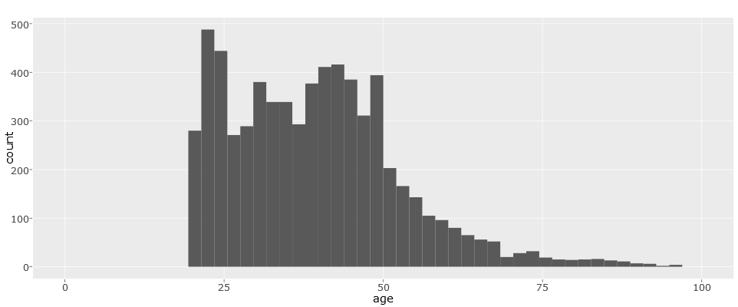
Age Distribution
Average age (20-50 yrs old): Approx. Mid 30s

Slide 8
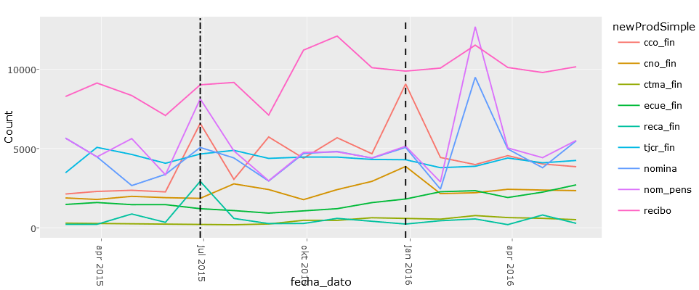
Top 9 Products
Products Owned by December 2015
Products Owned by June 2015

Slide 9
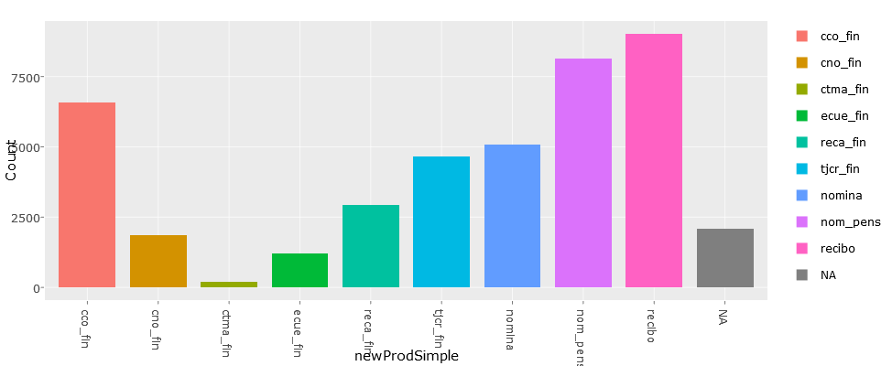
Product Analysis on June 2015 (Visualization)
Direct Debit
Pensions
Current Account
Credit Card
Payroll
Payroll Account
taxes
Mas Particular Account
e-account

Slide 10
Crucial Insights based on June 2015 Record (Indicators)
Products owned in June contains a unique product distribution than other months (probably because it marks the end of tax year in spain)
*Cco_fin (current account) and Reca_fin (taxes) in particular has a unique product distribution than others in June 2015.

Slide 11

Pearson (Correlation)similarity measurement
Pearson or Correlation similarity measurement that works by comparing how much does a pair of own products (“i” and “j” are products) owned by a customer deviates from the average owned product (or most commonly owned products by all customers)

Slide 12
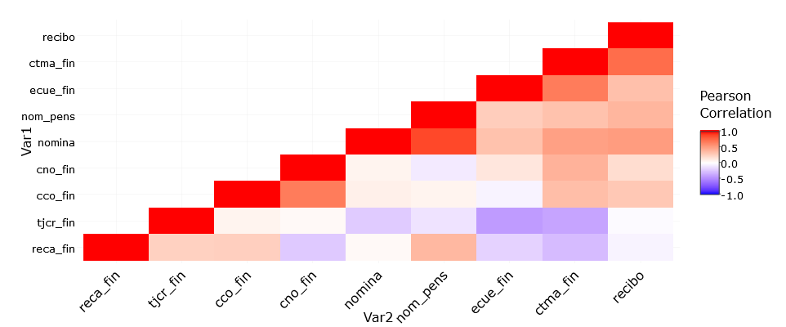
Product-to-Product Correlations

Slide 13
Insights
Relation between Nom_pens (pensions) and Nomina (Payroll), Nomina product are bought iff Nom_pens was owned in the previous month or if it is bought together in the same month with Nom_pens.

Slide 14
B Feature Engineering
Data Split (for data training):
By Months (7 Lags/split): June 2015, December 2015, January 2016 - March 2016, and May 2016.
By new customer records: merge all data between above January 2016 - April 2016 and exclude records which have new product into different split (i.e. 1 split).
Validation:
Cco_fin prediction is validated based on December’s 2015 (2015-12-28) data only
While reca_fin is based on June 2015 data (2015-06-28) only
Others were based on May 2016 (2016-05-28) data only

Slide 15
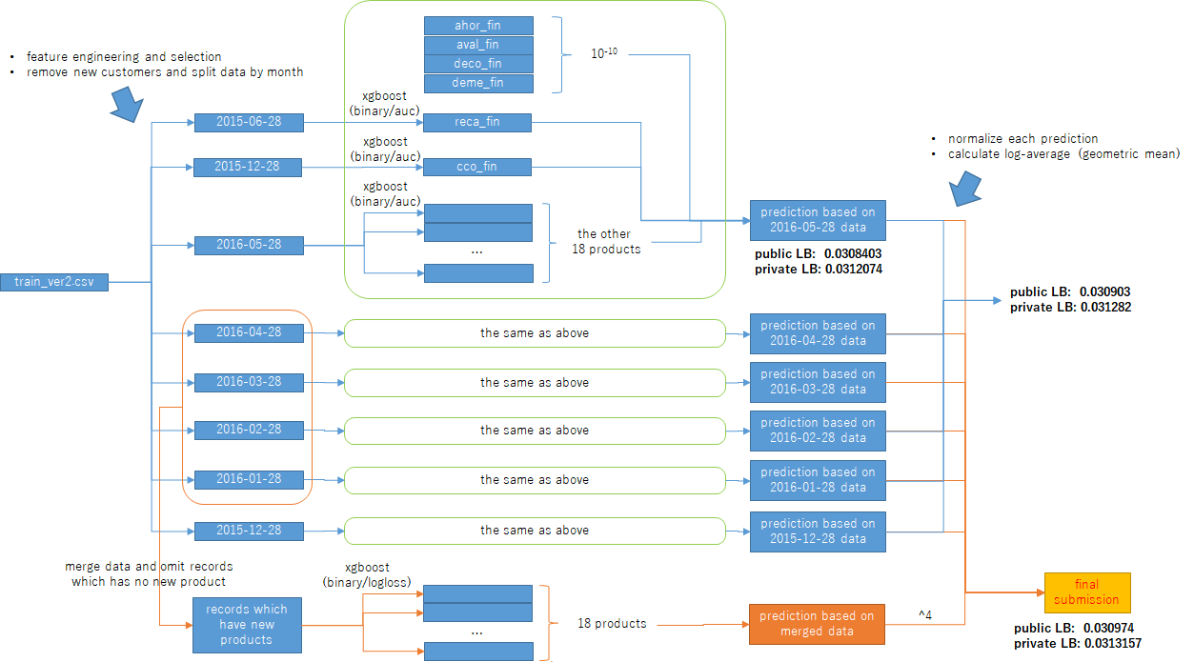

Slide 16
C. Base Model
XgBoost, an implementation of gradient boosted decision trees designed for speed and performance. (performed better with well-structured or well-defined data).
Classification Model: Binary
2 types of Metrics used:
Logloss (for records that have new products)
Area Under the Curve (AUC)
Product Prediction basis:
2015-06-28 record for “reca_fin (taxes)”
2015-12-28 record for “cco_fin (current account)”
2016-05-28 record for the remaining products (18 in total)
In addition, the remaining records which has new purchased products will also be predicted by data from 2015-12-28 to 2016-04-28 (5 lags).

Slide 17

Xgboost Model : Model and Parameters
The model in supervised learning usually refers to the mathematical structure of how to make the prediction yi given xi. For example, a common model is a linear model, where the prediction is given by
a linear combination of weighted input features. The prediction value can have different interpretations, depending on the task, i.e., regression or classification. For example, it can be logistic transformed to get the probability of positive class in logistic regression, and it can also be used as a ranking score when we want to rank the outputs.

Slide 18


Objective Function : Training Loss + Regularization
Based on different understandings of yi, we can have different problems, such as regression, classification, ordering, etc. We need to find a way to find the best parameters given the training data. In order to do so, we need to define a so-called objective function, to measure the performance of the model given a certain set of parameters. A very important fact about objective functions is they must always contain two parts: training loss and regularization.
where L is the training loss function, and Ω is the regularization term. The training loss measures how predictive our model is on training data. For example, a commonly used training loss is mean squared error.
The regularization term is what people usually forget to add. The regularization term controls the complexity of the model, which helps us to avoid overfitting

Slide 19

Logarithmic Loss (LogLoss)
This is the multi-class version of the Logarithmic Loss metric. Each observation is in one class and for each observation, a predicted probability will be submitted for each class.
Where N is the number of observations, M is the number of class labels, log is the natural logarithm, yi,j is 1 if observation i is in class j and 0 otherwise, and pi,j is the predicted probability that observation i is in class j.
Note: Both the solution file and the submission file are CSV's where each row corresponds to one observation, and each column corresponds to a class. The solution has 1's and 0's (exactly one "1" in each row), while the submission consists of predicted probabilities.

Slide 20
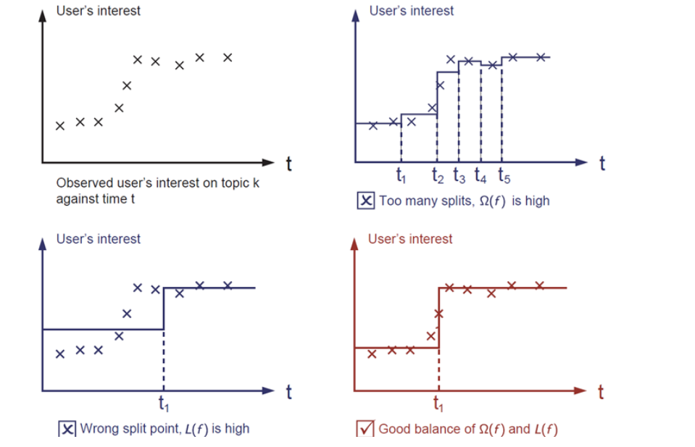
Which solution among the three do you think is the best fit?
The correct answer is marked in red. Please consider if this visually seems a reasonable fit to you. The general principle is we want both a simple and predictive model. The tradeoff between the two is also referred as bias-variance tradeoff in machine learning.

Slide 21
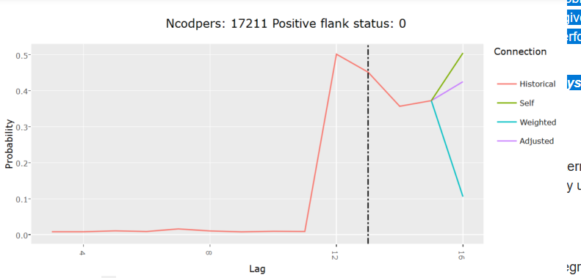
Best Fit Model Sample (Product: Recibo)
Regression
Iteration takes place in the training process until it produces the best fit!

Slide 22
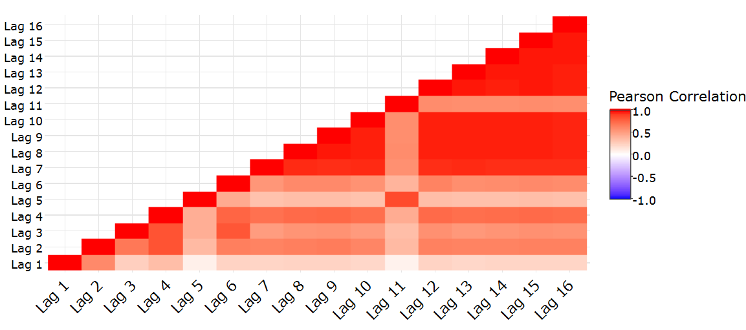
Base Model Correlation
Classification

Slide 23
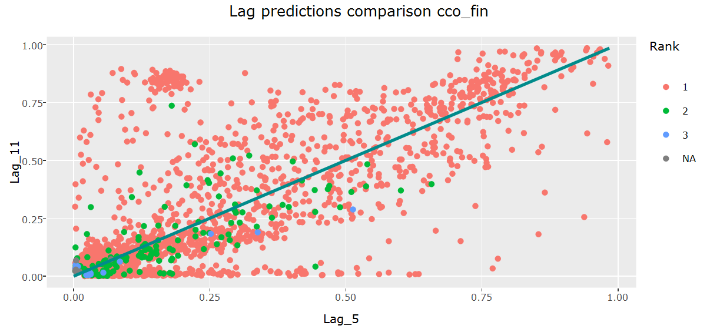
Lag predictions comparison (Cco_fin)
Ordering/Ranking

Slide 24
Logloss vs Area Under Curve (AUC)
Logloss, is used as a error metric for classification problem.
Area Under Curve (AUC), a metric type that is only sensitive to the order (i.e. used when we are concerned with the data order).
It is used based on two different problems: regression (linear regression, e.g. to get probability of positive flanks) or classification (ordering, e.g. ranking score when outputs needs to be ranked)

Slide 25
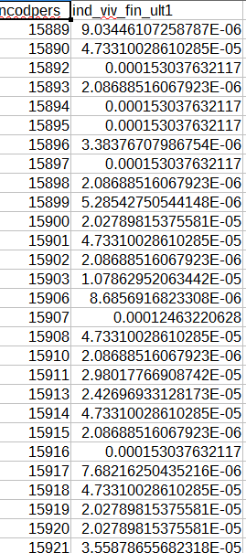
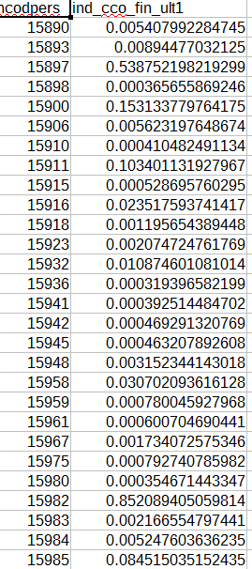
Logloss output vs Area Under Curve (AUC) Output

Slide 26

D. Submission
Submissions are evaluated according to the Mean Average Precision @ 7 MAP@7:
where |U| is the number of rows usersintwotimepoints, Pk is the precision at cutoff k, n is the number of predicted products, and m is the number of added products for the given user at that time point. If m = 0, the precision is defined to be 0.

Slide 27
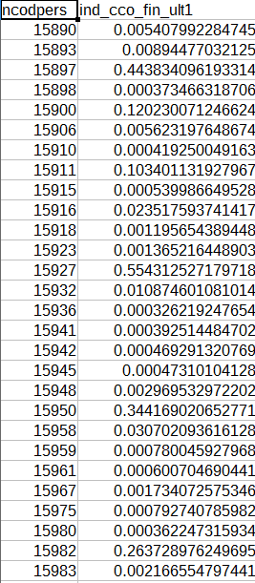
D. Submission (Single Product Sample)

Slide 28
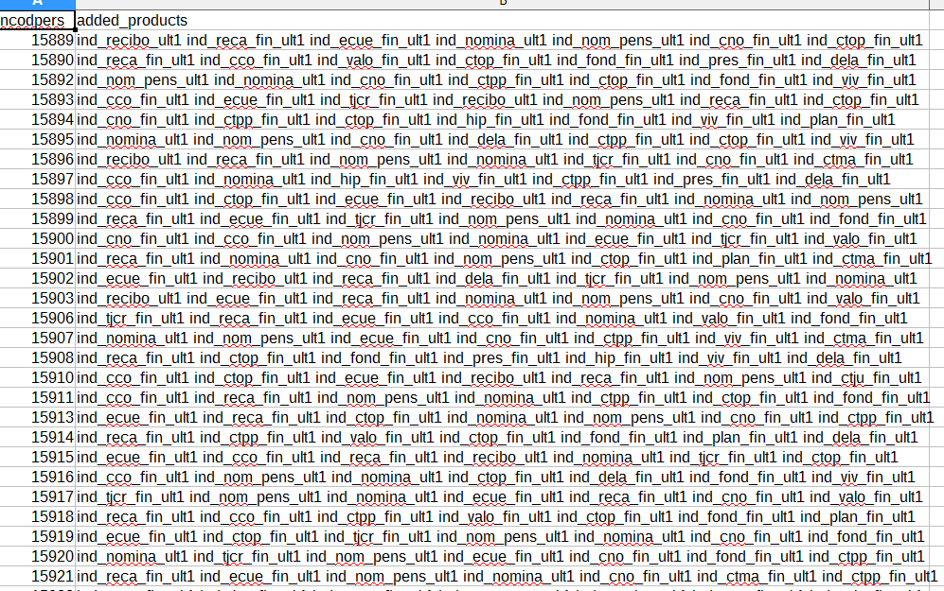
D. Submission (Final Merge Sample)

Slide 29
3. Conclusion
To summarize, the key steps are:
Observation (EDA)
Data classification (i.e. record split)
Base Modelling (Xgboost)
Training data selection (e.g. to find the best fit Model and produce final prediction based on the assigned value/record)
Final Submission (in .csv format)
All of these steps are based on the Product ownership history/records.
// Final Submission Score (based on MAP@7): 0.0306103 in public LB and 0.0311074 in private LB

Slide 30
Q & A
Any Questions?

